Slide 1
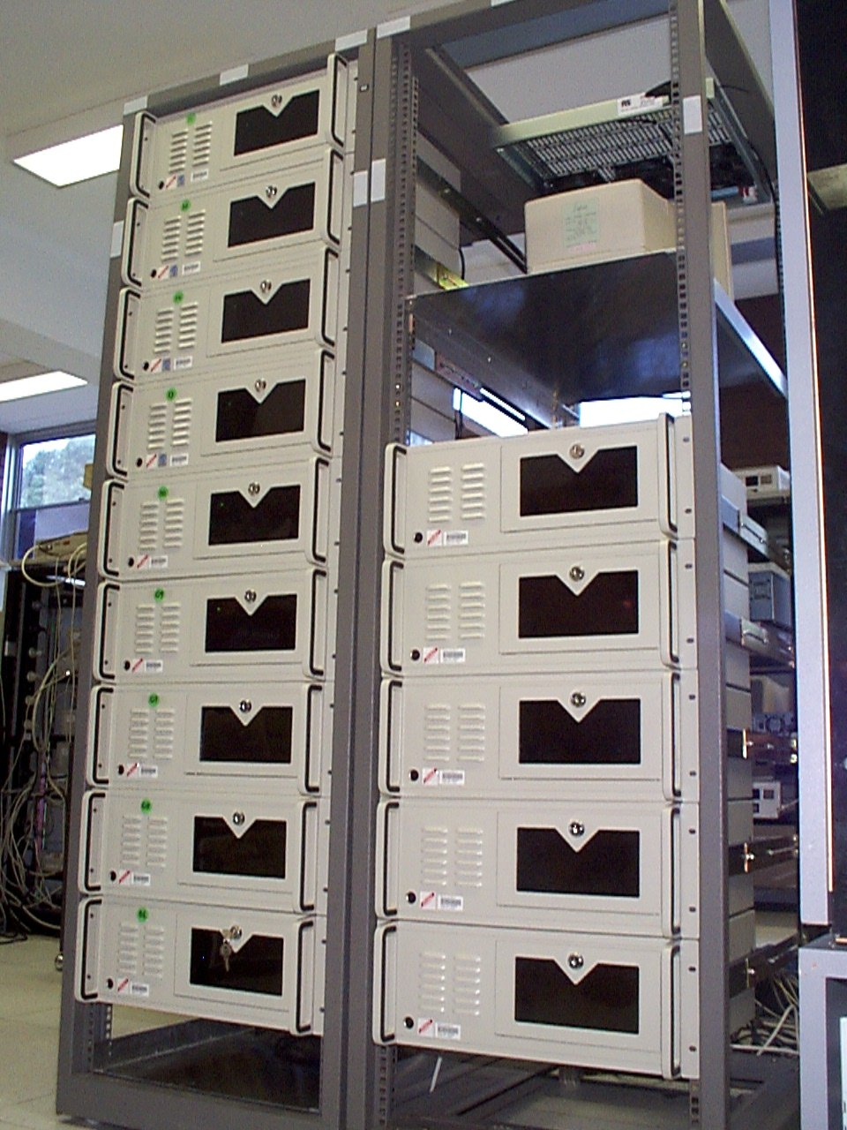
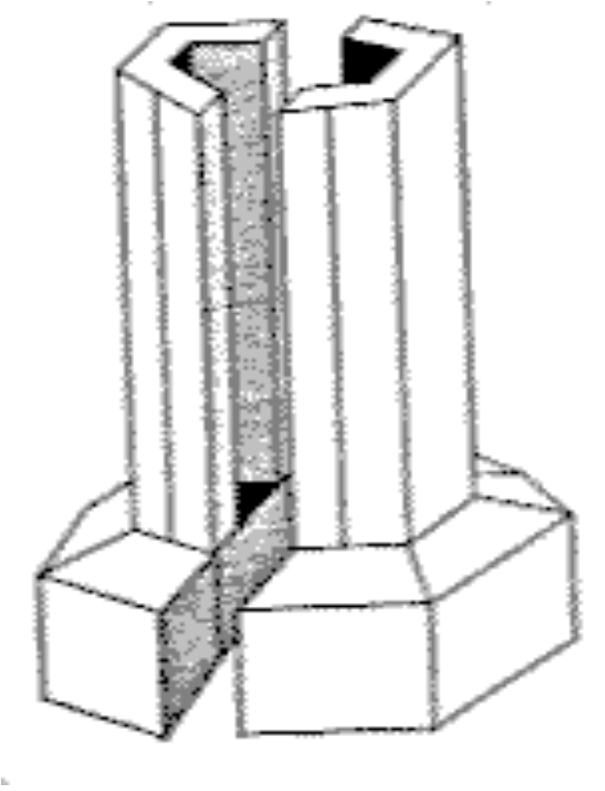

Cluster Computing
The promise of supercomputing to the average PC User ?
Notes:
3

Slide 2

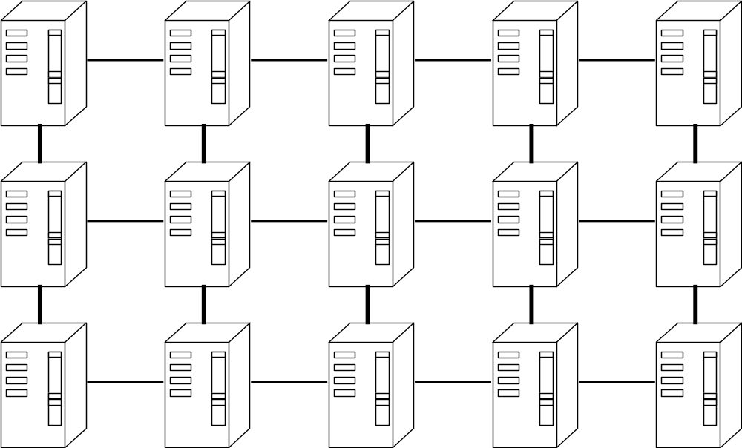
Low Cost Supercomputing
No
Parallel Processing on Linux Clusters
Rajkumar Buyya, Monash University, Melbourne, Australia.
rajkumar@ieee.org http://www.csse.monash.edu.au/~rajkumar

Slide 3

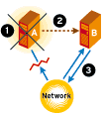
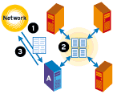
Agenda
Cluster ? Enabling Tech. & Motivations
Cluster Architecture
Cluster Components and Linux
Parallel Processing Tools on Linux
Software Tools for Clusters
Cluster Computing in Melbourne
Cluster Programming and Application Design
Resources and Conclusions

Slide 4
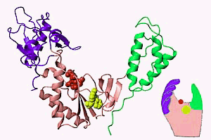








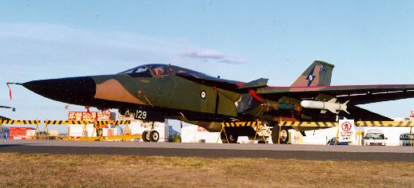
Computing Power (HPC) Drivers
Solving grand challenge applications using computer modeling, simulation and analysis
Aerospace
Life Sciences
Internet &
Ecommerce
CAD/CAM
Digital Biology
Military Applications
Military Applications
Military Applications

Slide 5
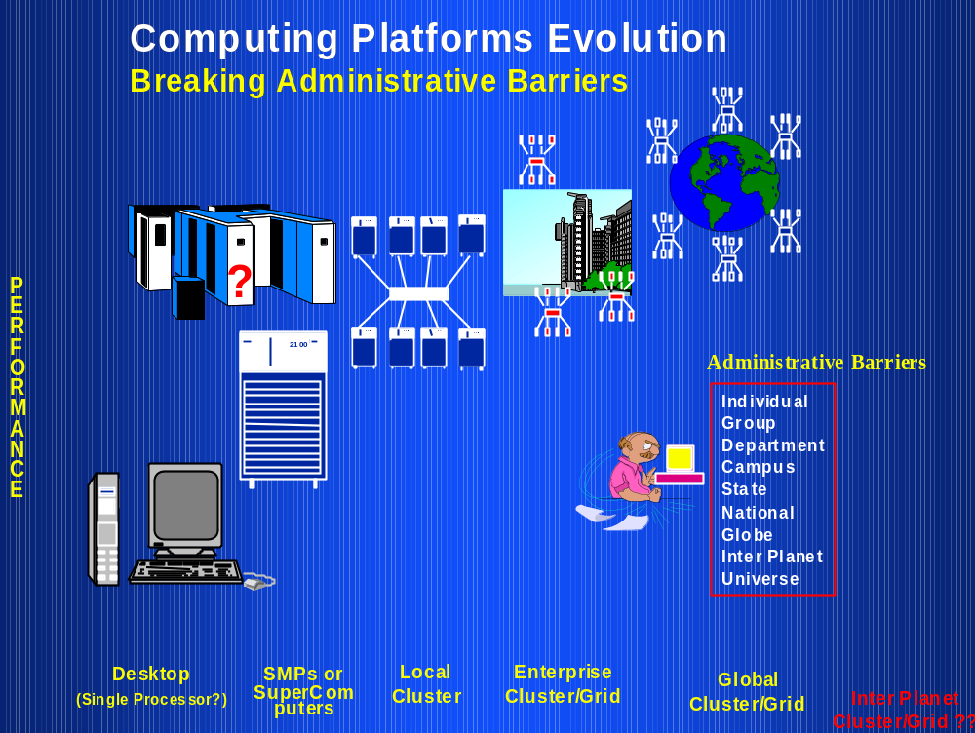

Slide 6
Two Eras of Computing
Architectures
System Software
Applications
P.S.Es
Architectures
System Software
Applications
P.S.Es
Sequential
Era
Parallel
Era
1940 50 60 70 80 90 2000 2030
Commercialization
R & D Commodity

Slide 7
Raise and Fall of Computer Architectures
Vector Computers (VC) ---proprietary system
  provided the breakthrough needed for the emergence of computational science, buy they were only a partial answer.
Massively Parallel Processors (MPP)-proprietary system
  high cost and a low performance/price ratio.
Symmetric Multiprocessors (SMP)
  suffers from scalability
Distributed Systems
  difficult to use and hard to extract parallel performance.
Clusters -- gaining popularity
  High Performance Computing---Commodity Supercomputing
  High Availability Computing ---Mission Critical Applications

Slide 8
Technology Trend...
Performance of PC/Workstations components has almost reached performance of those used in supercomputers…
  Microprocessors (50% to 100% per year)
  Networks (Gigabit ..)
  Operating Systems
  Programming environment
  Applications
Rate of performance improvements of commodity components is too high.

Slide 9
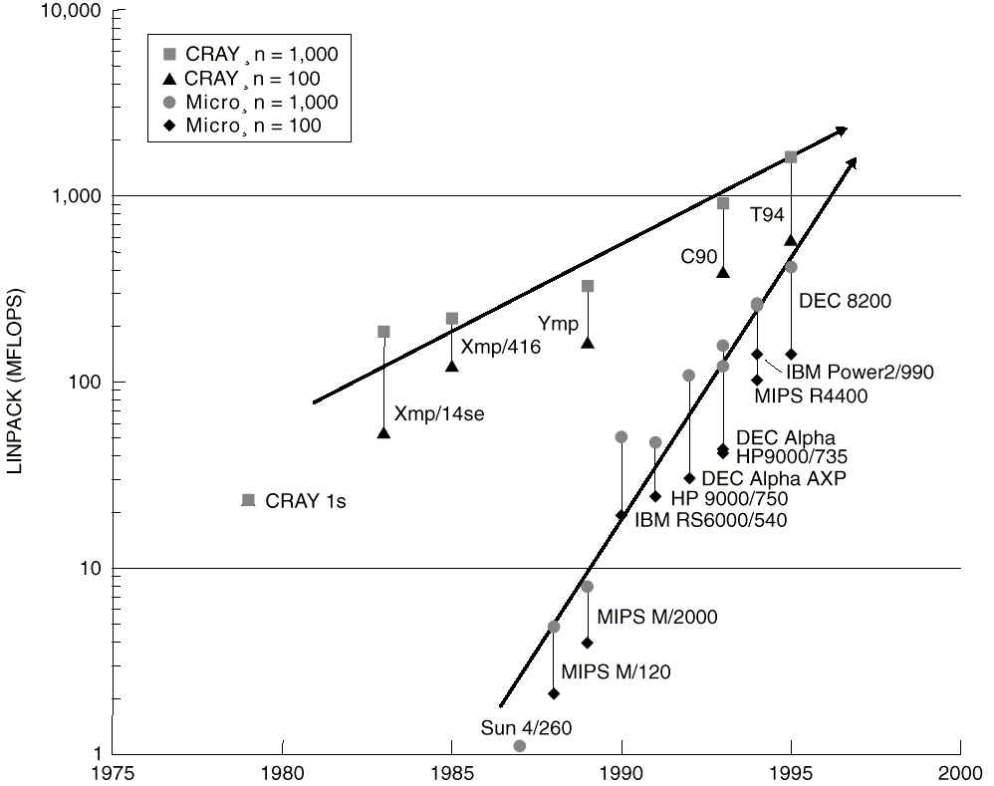
Technology Trend

Slide 10
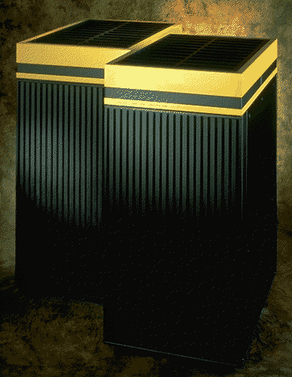
The Dead Supercomputer Society http://www.paralogos.com/DeadSuper/
Dana/Ardent/Stellar
Denelcor
Elxsi
ETA Systems
Evans and Sutherland
Computer Division
Floating Point Systems
Galaxy YH-1
Goodyear Aerospace MPP
Gould NPL
Guiltech
Intel Scientific Computers
Intl. Parallel Machines
Kendall Square Research
Key Computer Laboratories
MasPar
ACRI
Alliant
American Supercomputer
Ametek
Applied Dynamics
Astronautics
BBN
CDC
Convex
Cray Computer
Cray Research (SGI?Tera)
Culler-Harris
Culler Scientific
Cydrome
Meiko
Multiflow
Myrias
Numerix
Prisma
Thinking Machines
Saxpy
Scientific Computer Systems (SCS)
Soviet Supercomputers
Supertek
Supercomputer Systems
Suprenum
Vitesse Electronics
Convex C4600

Slide 11
The Need for Alternative Supercomputing Resources
Cannot afford to buy “Big Iron” machines
  due to their high cost and short life span.
  cut-down of funding
  don’t “fit” better into today's funding model.
Parallel Processing Paradox
  Time required to develop a parallel application for solving GCA is equal to Half Life of Parallel Supercomputers.
  Parallel program optimisation takes order of magnitude (10+ times) effort than its sequential counterpart.
  Limited machine life (yesterdays supercomputers performance is the same as today’s PC/Laptop)

Slide 12
Clusters are best-alternative!
Supercomputing-class commodity components are available
They “fit” very well with today’s/future funding model.
Can leverage upon future technological advances
  VLSI, CPUs, Networks, Disk, Memory, Cache, OS, programming tools, applications,...

Slide 13
Best of both Worlds!
High Performance Computing (talk focused on this)
  parallel computers/supercomputer-class workstation cluster
  dependable parallel computers
High Availability Computing
  mission-critical systems
  fault-tolerant computing

Slide 14
What is a cluster?
A cluster is a type of parallel or distributed processing system, which consists of a collection of interconnected stand-alone computers cooperatively working together as a single, integrated computing resource.
A typical cluster:
  Network: Faster, closer connection than a typical network (LAN)
  Low latency communication protocols
  Looser connection than SMP

Slide 15
So What’s So Different about Clusters?
Commodity Parts?
Communications Packaging?
Incremental Scalability?
Independent Failure?
Intelligent Network Interfaces?
Complete System on every node
  virtual memory
  scheduler
  files
  …
Nodes can be used individually or combined...

Slide 16

History: Clustering of Computers for Collective Computing
1960
1990
1995+

Slide 17
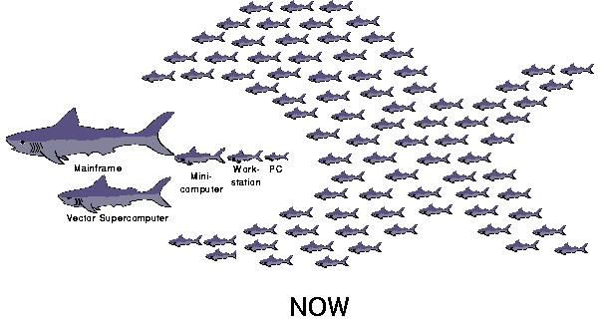
Computer Food Chain (Now and Future)
Demise of Mainframes, Supercomputers, & MPPs
Notes:
2

Slide 18
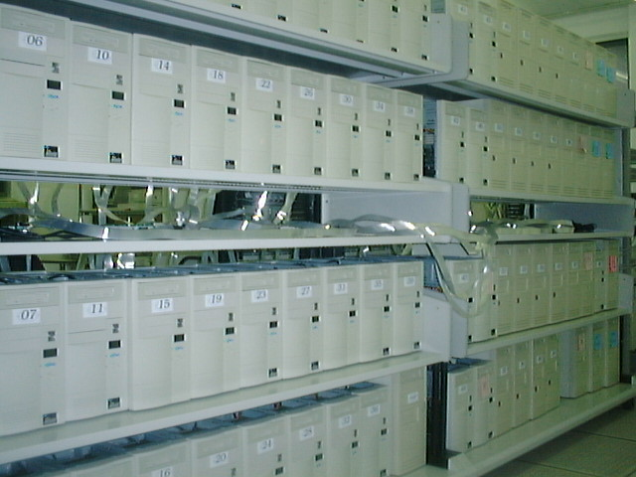
Cluster Configuration..1
Dedicated Cluster
Notes:
3

Slide 19

Cluster Configuration..2
Enterprise Clusters (use JMS like Codine)
Shared Pool of
Computing Resources:
Processors, Memory, Disks
Interconnect
Guarantee at least one
workstation to many individuals
(when active)
Deliver large % of collective
resources to few individuals
at any one time
Notes:
3

Slide 20
Windows of Opportunities
MPP/DSM:
  Compute across multiple systems: parallel.
Network RAM:
  Idle memory in other nodes. Page across other nodes idle memory
Software RAID:
  file system supporting parallel I/O and reliability, mass-storage.
Multi-path Communication:
  Communicate across multiple networks: Ethernet, ATM, Myrinet

Slide 21
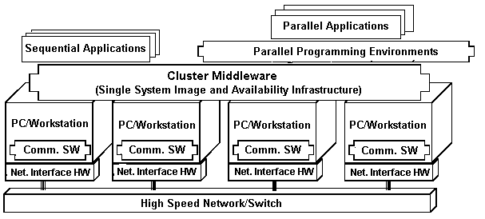
Cluster Computer Architecture

Slide 22

Major issues in cluster design
Size Scalability (physical & application)
Enhanced Availability (failure management)
Single System Image (look-and-feel of one system)
Fast Communication (networks & protocols)
Load Balancing (CPU, Net, Memory, Disk)
Security and Encryption (clusters of clusters)
Distributed Environment (Social issues)
Manageability (admin. And control)
Programmability (simple API if required)
Applicability (cluster-aware and non-aware app.)

Slide 23
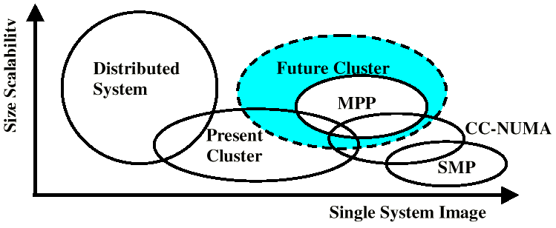
Scalability Vs. Single System Image
UP

Slide 24
Linux-based Tools for
High Availability Computing
High Performance Computing

Slide 25
Hardware
Linux OS is running/driving...
  PCs (Intel x86 processors)
  Workstations (Digital Alphas)
  SMPs (CLUMPS)
  Clusters of Clusters
Linux supports networking with
  Ethernet (10Mbps)/Fast Ethernet (100Mbps),
  Gigabit Ethernet (1Gbps)
  SCI (Dolphin - MPI- 12micro-sec latency)
  ATM
  Myrinet (1.2Gbps)
  Digital Memory Channel
  FDDI

Slide 26
Communication Software
Traditional OS supported facilities (heavy weight due to protocol processing)..
  Sockets (TCP/IP), Pipes, etc.
Light weight protocols (User Level)
  Active Messages (AM) (Berkeley)
  Fast Messages (Illinois)
  U-net (Cornell)
  XTP (Virginia)
  Virtual Interface Architecture (industry standard)

Slide 27
Cluster Middleware
Resides Between OS and Applications and offers in infrastructure for supporting:
  Single System Image (SSI)
  System Availability (SA)
SSI makes collection appear as single machine (globalised view of system resources). telnet cluster.myinstitute.edu
SA - Check pointing and process migration..

Slide 28
Cluster Middleware
OS / Gluing Layers
  Solaris MC, Unixware, MOSIX
  Beowulf “Distributed PID”
Runtime Systems
  Runtime systems (software DSM, PFS, etc.)
  Resource management and scheduling (RMS):
    CODINE, CONDOR, LSF, PBS, NQS, etc.

Slide 29
Programming environments
Threads (PCs, SMPs, NOW..)
  POSIX Threads
  Java Threads
MPI
  http://www-unix.mcs.anl.gov/mpi/mpich/
PVM
  http://www.epm.ornl.gov/pvm/
Software DSMs (Shmem)

Slide 30
Development Tools
GNU-- www.gnu.org
Compilers
  C/C++/Java/
Debuggers
Performance Analysis Tools
Visualization Tools

Slide 31
Killer Applications
Numerous Scientific & Engineering Apps.
Parametric Simulations
Business Applications
  E-commerce Applications (Amazon.com, eBay.com ….)
  Database Applications (Oracle on cluster)
  Decision Support Systems
Internet Applications
  Web serving
  Infowares (yahoo.com, AOL.com)
  ASPs (application service providers)
  eChat, ePhone, eBook, eCommerce, eBank, eSociety, eAnything!
  Computing Portals
Mission Critical Applications
  command control systems, banks, nuclear reactor control, star-war, and handling life threatening situations.

Slide 32

Linux Webserver
(Network Load Balancing)
http://www.LinuxVirtualServer.org/
High Performance (by serving through light loaded machine)
High Availability (detecting failed nodes and isolating them from the cluster)
Transparent/Single System view

Slide 33

Multicomputer OS for UNIX (MOSIX)
http://www.mosix.cs.huji.ac.il/
An OS module (layer) that provides the applications with the illusion of working on a single system
Remote operations are performed like local operations
Transparent to the application - user interface unchanged
Application
PVM / MPI / RSH
MOSIX
Offers missing link
Hardware/OS

Slide 34
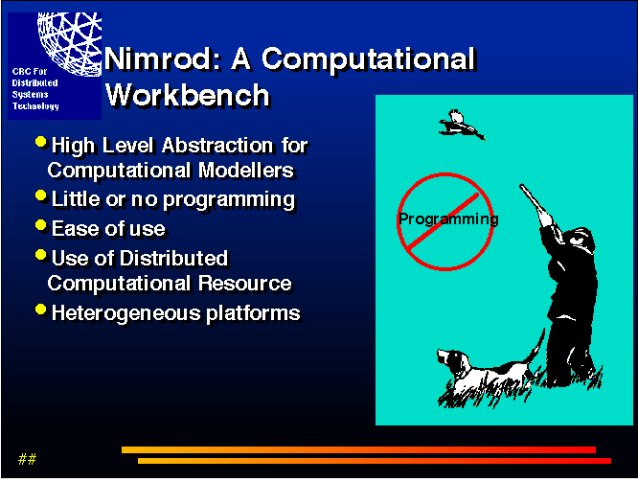
Nimrod - A tool for parametric modeling on clusters
http://www.dgs.monash.edu.au/~davida/nimrod.html

Slide 35
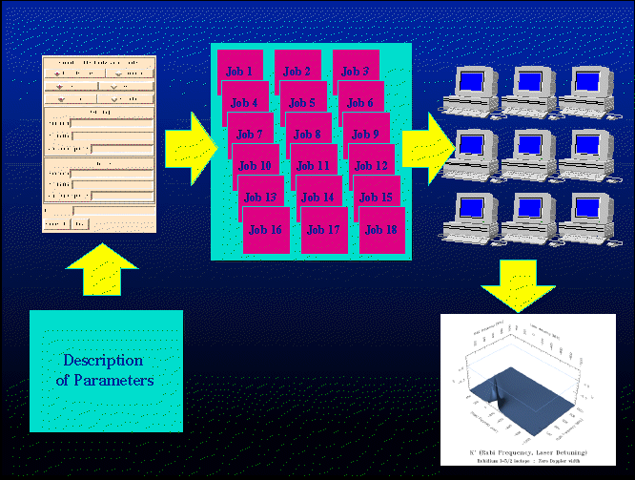
Job processing with Nimrod

Slide 36
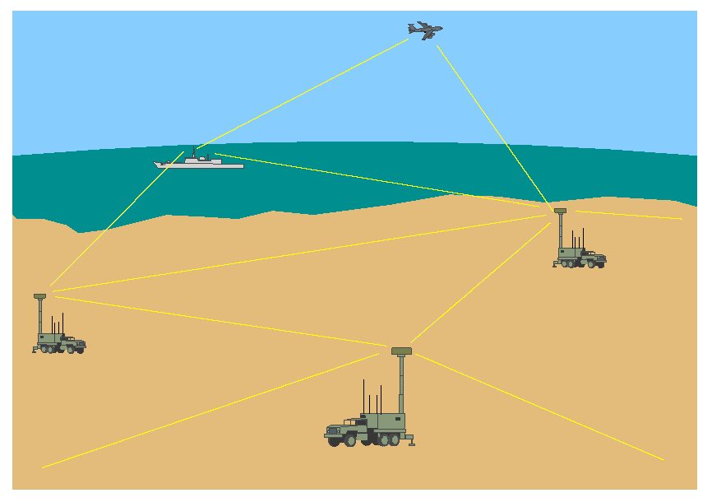
Ad Hoc Mobile Network Simulation
Ad Hoc Mobile Network Simulation (C. Koop, Monash): Network performance under different microware frequencies and different Weather conditions -- Used Nimrod

Slide 37




PARMON: A Cluster Monitoring Tool
PARMON Server
on each node
PARMON Client on JVM
parmon
parmond
PARMON
High-Speed
Switch
Notes:
4

Slide 38
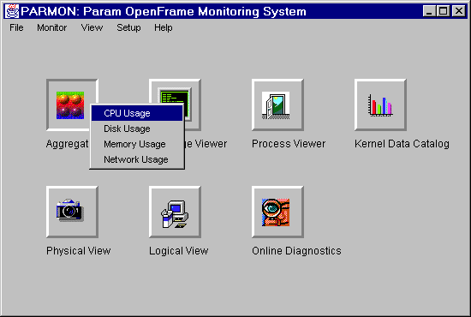
Resource Utilization at a Glance

Slide 39
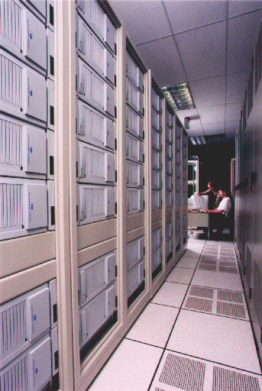
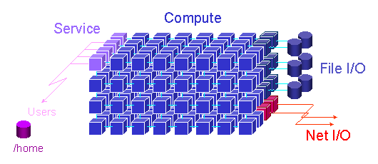
Linux cluster in Top500 http://www.cs.sandia.gov/cplant/
Top500 Supercomputing site (www.top500.org) declared
CPlant cluster, the 62nd most powerful computer in the world.
592 DEC Alpha cluster, Redhat Linux, Myrinet
Completely commodity and Free Software
113th Avalon cluster in ‘99 de-promoted tp 364th position.

Slide 40








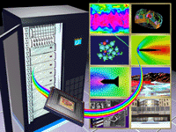

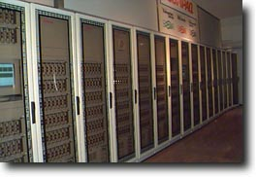




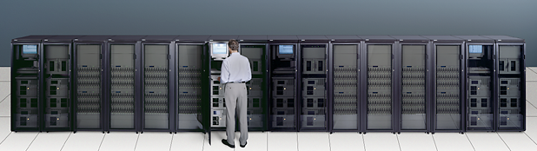




Adoption of the Approach

Slide 41
Cluster Computing in Melbourne
Monash University
  CS and Maths dept.
RMIT
  Eddie webserver
Swinburne Uni
  Astrophysics
Uni. of Melbourne ?
Deakin University
  Operating System (OS) research
Soon (federally and state funded initiative to compliment APAC national initiative to position AU in one of the top 10 countries in HPC.
Victorian Partnership of Advanced Computing (VPAC)

Slide 42
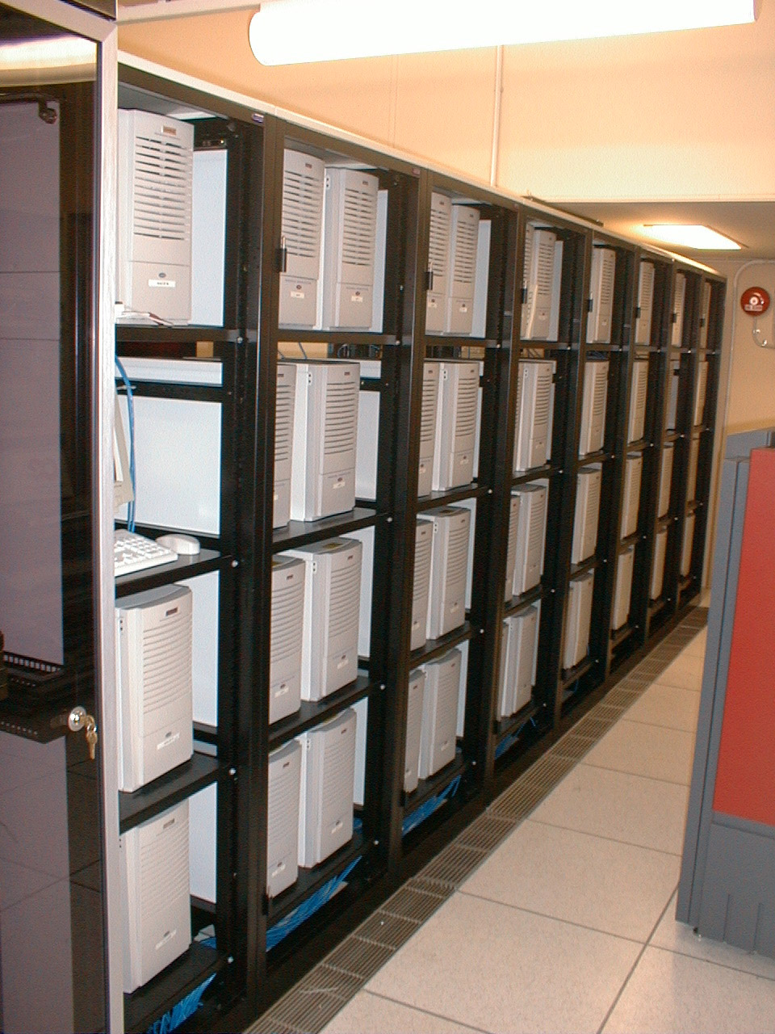

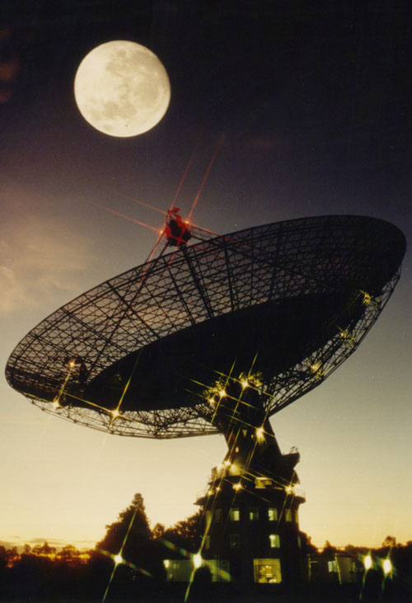
Austrophysics on Clusters! Swinburne: http://www.swin.edu.au/astronomy/
Pulsar detection
65 node workstation farm (66GF)
Parkes 64-m radio telescope
http://wwwatnf.atnf.csiro.au/

Slide 43



Cluster Forum
IEEE Task Force on Cluster Computing
(TFCC)
http://www.ieeetfcc.org
Co-Chairs: Rajkumar Buyya (AU) and Mark Baker (UK)

Slide 44
CLUSTER PROGRAMMING and Application Design
(if TIME available), otherwise SKIP

Slide 45
Cluster Programming Environments
Shared Memory Based
  DSM
  Threads/OpenMP (enabled for clusters)
  Java threads (HKU JESSICA, IBM cJVM)
Message Passing Based
  PVM (PVM)
  MPI (MPI)
Parametric Computations
  Nimrod/Clustor
Automatic Parallelising Compilers
Parallel Libraries & Computational Kernels (NetSolve)
Notes:
14

Slide 46


Levels of Parallelism
Code-Granularity
Code Item
Large grain
(task level)
Program
Medium grain
(control level)
Function (thread)
Fine grain
(data level)
Loop (Compiler)
Very fine grain
(multiple issue)
With hardware
PVM/MPI
Task i-l
Task i
Task i+1
func1 ( )
{
....
....
}
func2 ( )
{
....
....
}
func3 ( )
{
....
....
}
Threads
Compilers
a ( 0 ) =..
b ( 0 ) =..
a ( 1 )=..
b ( 1 )=..
a ( 2 )=..
b ( 2 )=..
CPU
+
x
Load

Slide 47
MPI (Message Passing Interface)
http://www.mpi-forum.org/
A standard message passing interface.
  MPI 1.0 - May 1994 (started in 1992)
  C and Fortran bindings (now Java)
Portable (once coded, it can run on virtually all HPC platforms including clusters!
Performance (by exploiting native hardware features)
Functionality (over 115 functions in MPI 1.0)
  environment management, point-to-point & collective communications, process group, communication world, derived data types, and virtual topology routines.
Availability - a variety of implementations available, both vendor and public domain.
Notes:
14

Slide 48
A Sample MPI Program...
(master)
# include <stdio.h>
# include <string.h>
#include “mpi.h”
main( int argc, char *argv[ ])
{
int my_rank; /* process rank */
int p; /*no. of processes*/
int source; /* rank of sender */
int dest; /* rank of receiver */
int tag = 0; /* message tag, like “email subject” */
char message[100]; /* buffer */
MPI_Status status; /* function return status */
/* Start up MPI */
MPI_Init( &argc, &argv );
/* Find our process rank/id */
MPI_Comm_rank( MPI_COM_WORLD, &my_rank);
/*Find out how many processes/tasks part of this run */
MPI_Comm_size( MPI_COM_WORLD, &p);
Hello,...
…
(workers)
Notes:
14

Slide 49
A Sample MPI Program
if( my_rank == 0) /* Master Process */
{
for( source = 1; source < p; source++)
{
MPI_Recv( message, 100, MPI_CHAR, source, tag, MPI_COM_WORLD, &status);
printf(“%s \n”, message);
}
}
else /* Worker Process */
{
sprintf( message, “Hello, I am your worker process %d!”, my_rank );
dest = 0;
MPI_Send( message, strlen(message)+1, MPI_CHAR, dest, tag, MPI_COM_WORLD);
}
/* Shutdown MPI environment */
MPI_Finalise();
}
Notes:
14

Slide 50
Execution
% cc -o hello hello.c -lmpi
% mpirun -p2 hello
Hello, I am process 1!
% mpirun -p4 hello
Hello, I am process 1!
Hello, I am process 2!
Hello, I am process 3!
% mpirun hello
(no output, there are no workers.., no greetings)
Notes:
14

Slide 51

Image-Rendering http://www.swin.edu.au/astronomy/pbourke/povray/parallel/

Slide 52
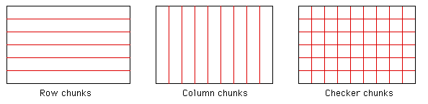
Parallelisation of Image Rendering
Image Splitting (by rows, columns, and checker)
Each segment can be concurrently processed on different nodes and render image as segments are processed.

Slide 53
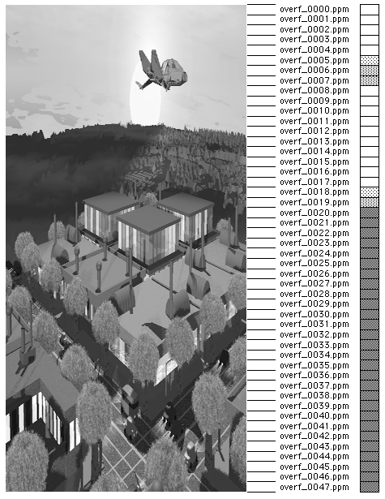
Scheduling (need load balancing)
Each row rendering takes different times depending on image nature.
E.g, rendering rows across the sky take less time compared to those that intersect the interesting parts of the image.
Rending Apps can be implemented using MPI, PVM, or p-study tools like Nimrod and schedule.

Slide 54
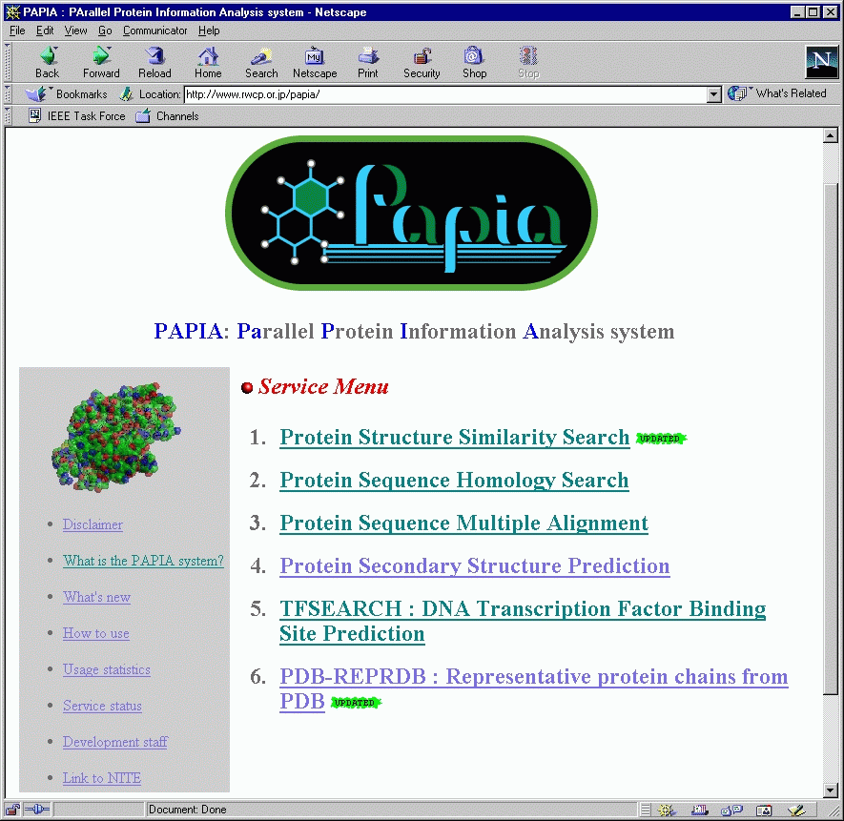
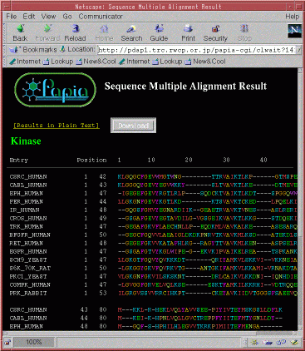
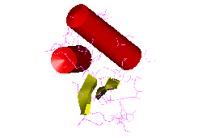
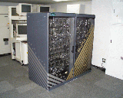
Science Portals - e.g., PAPIA system
Pentiums
Myrinet
NetBSD/Linuux
PM
Score-D
MPC++
RWCP Japan: http://www.rwcp.or.jp/papia/
PAPIA PC Cluster

Slide 55
Conclusions Remarks
Clusters are promising..
  Solve parallel processing paradox
  Offer incremental growth and matches with funding pattern
  New trends in hardware and software technologies are likely to make clusters more promising and fill SSI gap..so that
  Clusters based supercomputers (Linux based clusters) can be seen everywhere!

Slide 56
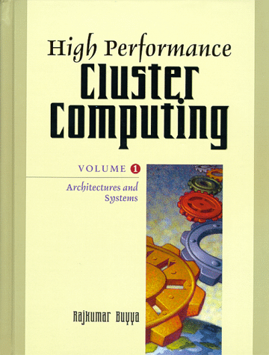
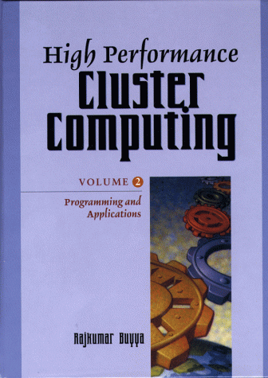
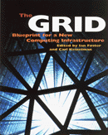

Further Information
Cluster Computing Infoware:
  http://www.buyya.com/cluster/
Grid Computing Infoware:
  http://www.gridcomputing.com
IEEE DS Online - Grid Computing area:
  http://computer.org/channels/ds/gc
Millennium Compute Power Grid/Market Project
  http://www.ComputePower.com
Books:
  High Performance Cluster Computing, V1, V2, R.Buyya (Ed), Prentice Hall, 1999.
  The GRID, I. Foster and C. Kesselman (Eds), Morgan-Kaufmann, 1999.
IEEE Task Force on Cluster Computing
  http://www.ieeetfcc.org
GRID Forums
  http://www.gridforum.org | http://www.egrid.org
CCGRID 2001, www.ccgrid.org
GRID Meeting - http://www.gridcomputing.org

Slide 57
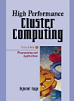
Cluster Computing Books
Thank You ...
?
http://www.csse.monash.edu.au/~rajkumar/cluster/

